Slide 1
MOT1421: Economic Foundations Week 4: Technological Change & Innovation
Lecture Note W4:
General concepts: technological change and innovation
Technological change: the neoclassical approach
o The growth accounting model of Robert Solow
Technological change: evolutionary economics

Slide 2
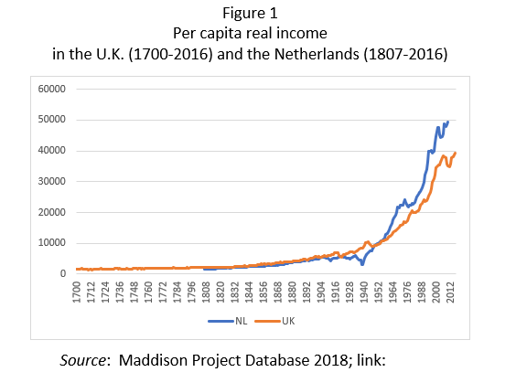
MOT1421: Economic Foundations Week 4: Technological Change
Living standards began to
rise following the
Industrial Revolution
(± 1800-1830) -> due to:
Technological progress
& capital formation (per
worker)

Slide 3
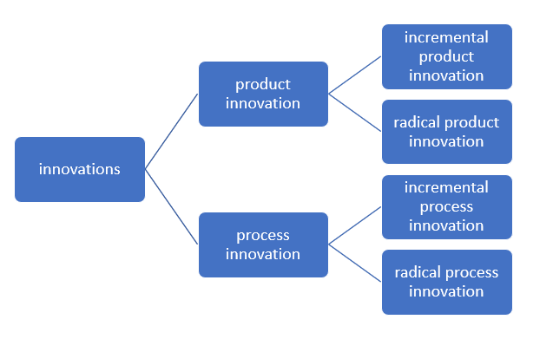

MOT1421: Economic Foundations Week 4: Technological Change
Innovation:
Technology-push
Demand-pull
(J. Schmookler)
National System of
Innovation (F. List).

Slide 4

MOT1421: Economic Foundations Week 4: Growth Accounting and TFP growth
Economic growth (rising per capita income at constant prices) depends on:
Technological progress
Rising capital intensity (K/L ratio)
Question: how much does technological progress contribute to economic growth?
Method: the growth accounting model (Robert Solow)

Slide 5

MOT1421: Economic Foundations Week 4: Growth Accounting and TFP Growth
Based on a constant-returns-to-scale Cobb-Douglas production function, we can derive the following expression for the growth rate of per capita income (at constant prices) – see Lecture Note W-4:
where lambda-hat = the growth rate of per capita income (at constant prices); kappa-hat = the growth rate of capital intensity; and a-hat =the growth rate of total-factor-productivity (TFP) (= a measure of neutral technological progress); (1 – alpha) = the exponent for K in the Cobb-Douglas production function.

Slide 6
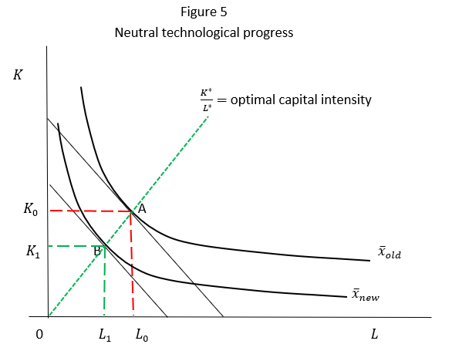
MOT1421: Economic Foundations Week 4: Growth Accounting and TFP Growth
TFP growth =
neutral
technological
progress.

Slide 7

MOT1421: Economic Foundations Week 4: Growth Accounting and TFP Growth
TFP growth is determined as a RESIDUAL.
Assume that we have the following (historical) data on:
Lambda-hat = 2.5%
Kappa-hat = 3%
Alpha = 2/3
Then we can use:
to calculate TFP growth: a-hat = 2.5% - (1 – 2/3) x 3% = 1.5%
Conclusion: TFP growth “accounts for” 60 per cent of per capita real income growth. Note: TFP growth is also “a measure of our ignorance ........”

Slide 8
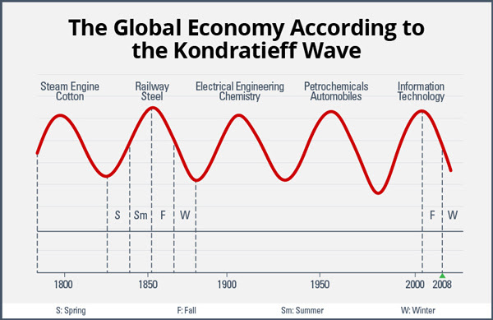
MOT1421: Economic Foundations Week 4: Technological Change: Evolutionary Economics
Joseph Schumpeter:
Economic growth is “driven”
by innovation.
Fluctuations in innovation
cause fluctuations in
investment and those cause
(long) cycles in economic
growth (booms & busts).

Slide 9
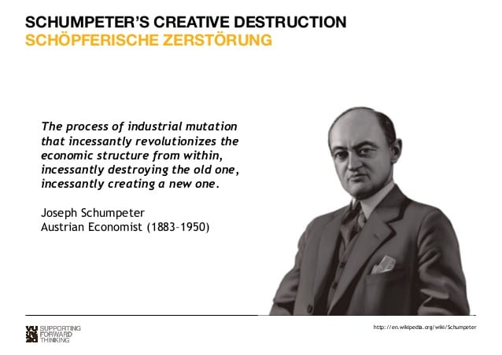
MOT1421: Economic Foundations Week 4: Technological Change: Evolutionary Economics
Joseph Schumpeter:
central role for the
profit-seeking
entrepreneur in
innovation.

Slide 10

MOT1421: Economic Foundations Week 4: Technological Change
Following the Schumpeterian approach, evolutionary economics places the firm and the entrepreneur at the centre of the theory.
Evolutionary economics rejects the neoclassical assumption of instrumental rationality, and instead uses the concepts of bounded rationality and routines.
A second building block of evolutionary economics is adaptation: routines get updated based on learning from experience. Other mechanisms are selection and imitation.
A third building block of evolutionary economics is technological path dependence.
(see QWERTY versus Dvorak)

Slide 11
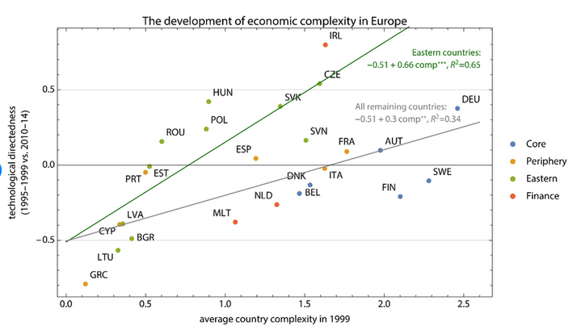
MOT1421: Economic Foundations Week 4: Path Dependence (at the country level)
Those EU countries
that had a better
technological starting
position in 1999 tend
to show a more
positive technological
development dynamic
during 2010-14.
Source: Gräbner et al. (2018).

Slide 12
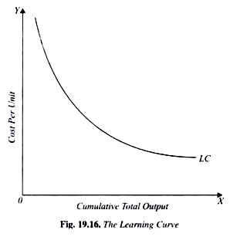
MOT1421: Economic Foundations Week 4: Path Dependence & increasing returns to scale
Suppose there are 2 firms in the market, each one of them using a different technology to produce a similar good/service. Each of the technologies exhibits increasing returns to scale, i.e. average cost of production decline as output expands.
Learning curve:
The firm that succeeds in running down
the learning curve the fastest, will out-
compete the other firm. ‘Initial conditions’
(history) matters; which technology comes
to dominate cannot be predicted.

Slide 13
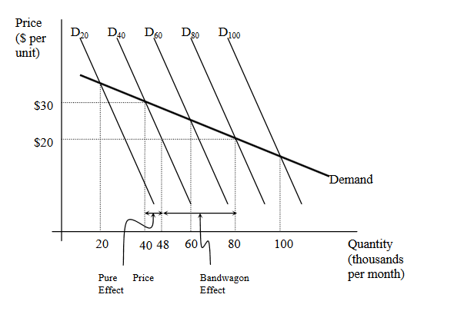
MOT1421: Economic Foundations Week 4: Path Dependence & Network Externalities
Positive network externalities:
the more people already
own a product in the market,
the more the demand for
that product will increase.
In this case, we will face
a so-called “Bandwagon effect”,
as every new consumer
will demand more than
she/he would have if there
hadn’t been a bandwagon to jump on to.
Examples: software; internet; credit cards; pharmaceuticals

Slide 14
MOT1421: Economic Foundations Week 4: Technological Change
An Evolutionary Market Model (HST Chapter 16)
Selection mechanism: firm with highest profit margin (= fittest firm) manages to increase its market share; the other two firms lose market share.
Imitation mechanism: (technologically) lagging firms imitate the leading firm, reduce unit cost and gain market share.
Note: selection is not necessarily favouring the efficient firm (with the lowest unit cost), but favour the fittest firm (which has the highest profit margin). The one that wins need not be the best—it may have come to dominate partially by chance.
IF THE SELECTION MECHANISM IS STRONG RELATIVE TO IMITATION -> TENDENCY TOWARDS MONOPOLY (CONCENTRATION ↑) | IF THE IMITATION MECHANISM IS STRONG RELATIVE TO SELECTION -> TENDENCY TOWARD OLIGOPOLY WITH STABLE MARKET SHARES

